Slide 1


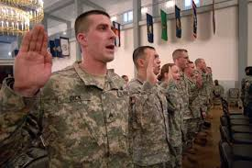
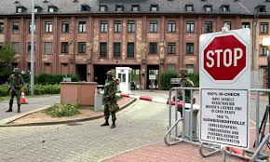
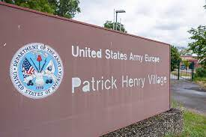
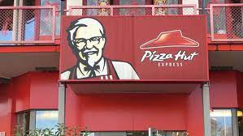
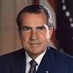

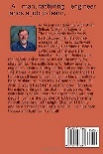
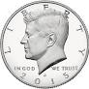




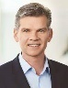
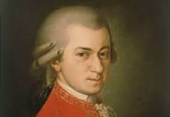
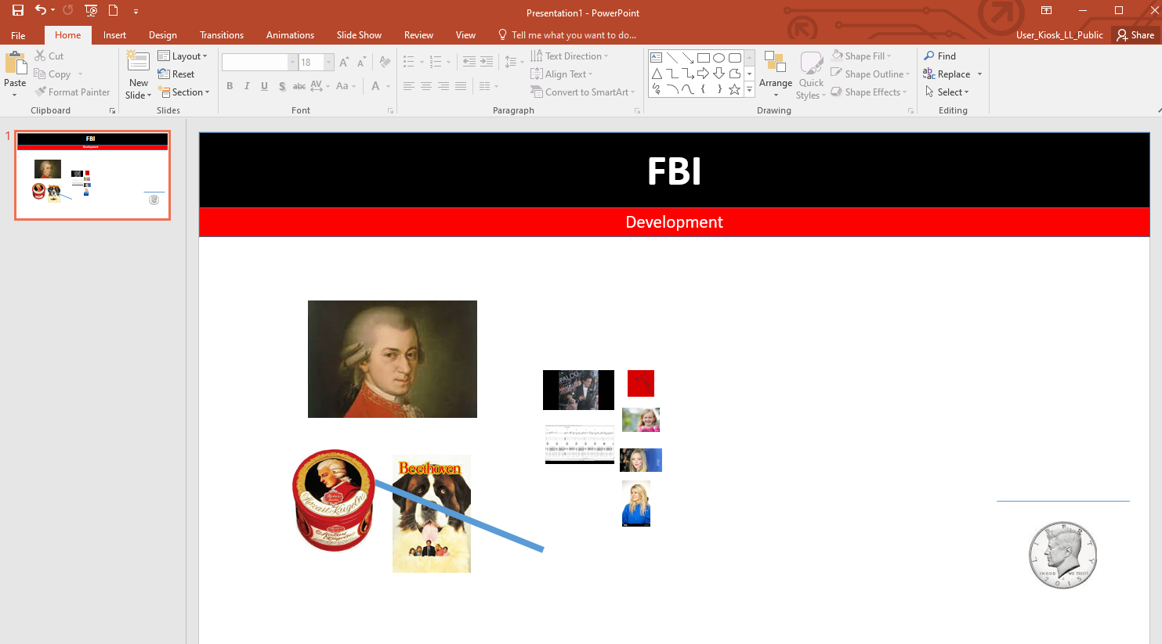


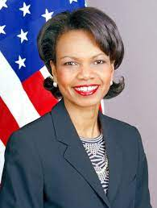


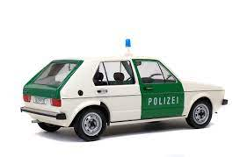
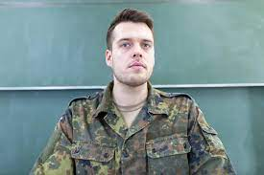
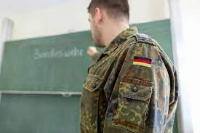
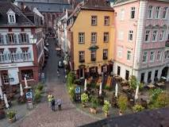
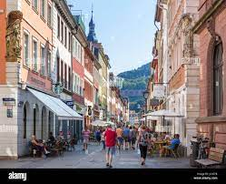
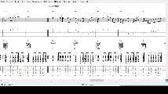
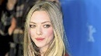
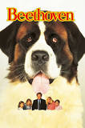
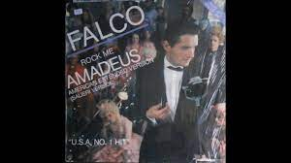

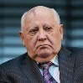

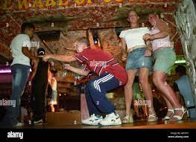
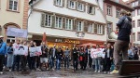
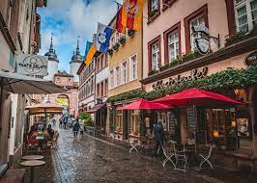
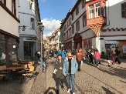
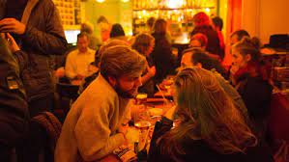
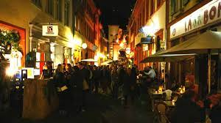
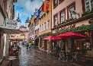
FBI
Development
WWI.NIXON
2010 Animoto
WWI.boat
Saint peter
Dr dr prod med. insutute
1D87(23)
Ghohe(dr).JOESPHE.Holger
HOMICE:JOHANNES($700/m father VP GERMANY deutsch uni Baden-Baden Goethe)
ksc
2017
Gohreoh(coolie)
POLICE SIRENS
Jenny
Coolie
fly

Slide 2
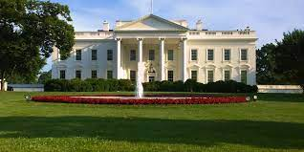
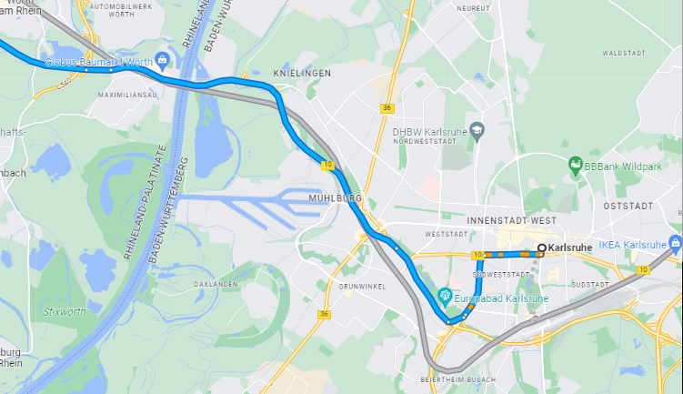
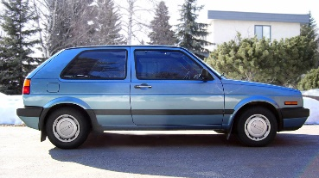

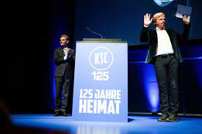
FBI
Development
41WWI.HOMICIDE:KYRSTAL
.(b10) !WHTIEHOUSE.LARRY.PHILLIS
VP GERMANY. Gobrachev(hager/heger,margo)

Slide 3
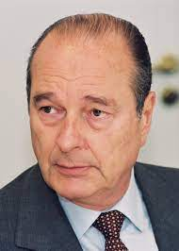
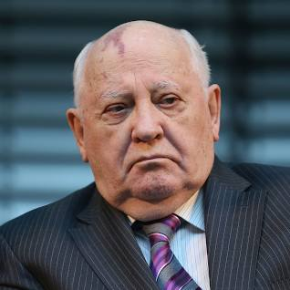
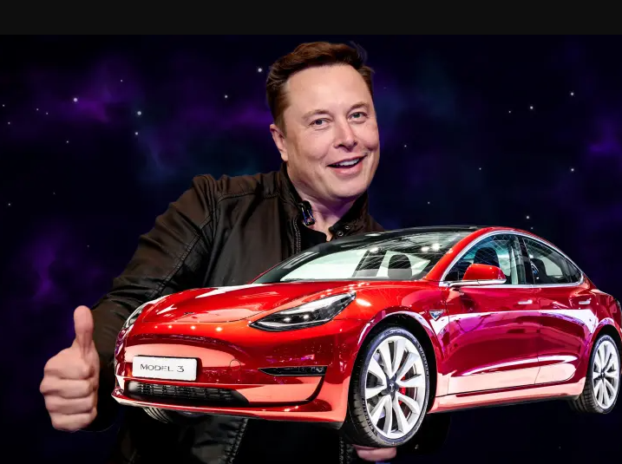
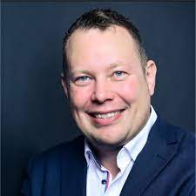
FBI
Development
phil.JFK.MLK

Slide 4
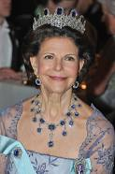

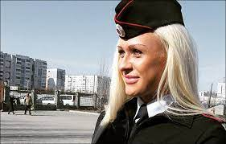
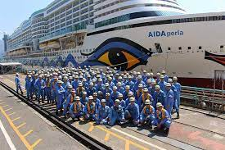
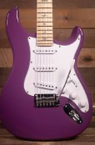
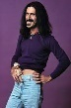
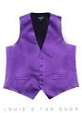
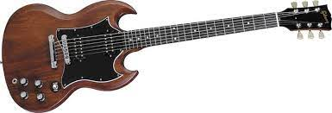
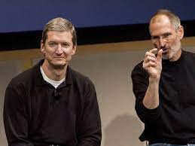

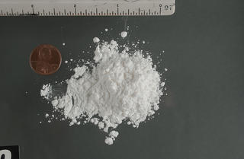
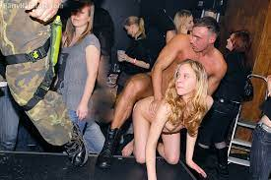
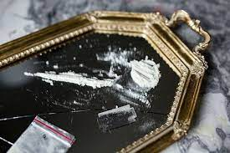
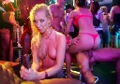
FBI
Development
2000 WAR.HOMICIDE:LUX:VHS (gorchev(dell.client.ushe.porno paint store)
41
HOMICID:CHANZELOR(Angel 20th Birthday)
LISA
LISA
“IDA”
breazil travel boat
41
Gorbachev(depress)
41

Slide 5

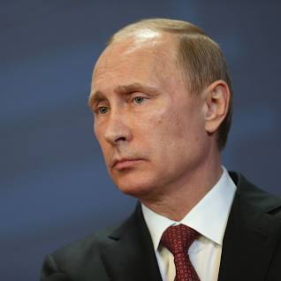
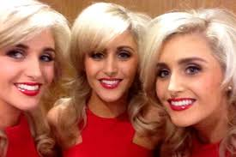
FBI
Development
Paul Sr.
Paul
Peter( Simon ) ma
FBI:WMD micro green

Slide 6









FBI
Development
2000 WAR.HOMICIDE:LUX
Guy died
8:53 Motyccle

Slide 7





FBI
Development
ATOMMICCITY(Philip burg )
TORT.MLK.aei.maxplank.marx
Call you rice?
41.CPVA
PRICE
FBI:WMD “bomber”

Slide 8












FBI
Development
Saint Patirk Heny Village
Gorgache(dj/dr/ LARRY magic mike)
HIEDILE BERG bigfm/black music ATB heidlerberg anatomy
WWI(café wien,ghoce(dj/dr)).IPX.ghcoheo(michala)
PRICE
INFORMATIK
BWL/ECONOMICS
WIRTSCHAFTSINFOMATIK
HOMICD:AUSLAENDER:FBI:KIDNAPPING
Marius 41.lsint(vggg. Bei nache un nebel, Auschwitz)
american pie university acceptance letter

Slide 9



FBI
Development
Auschwitz
Auschwitz, Gary
!Call you rice?
Auschwitz, phil.JFK.MLK

Slide 10













FBI
Development
VIRGINIA.FBI:SUITCASE
suitcase
BOB/KEN
Roghers?
FBI:WMD
Suitcase
INT PAUL PENTAGON DEA

Slide 11










FBI
Development
PAUL BARACKS
FRANKLIN.HOOVER.LANGLEY.MRS
CPVA
1945-2023+
1990=2023+

Slide 12
FBI
Development
PAUL BARACKS
FRANKLIN.HOOVER.LANGLEY.MRS

Slide 13





FBI
Development
BLIND SPOT:
Black Male – White Female
hudson
Black Female
Juneteent.CIVIL CODE.AVAIABILITY
Phil.JFK.MLK
MATHEW:SAINT RITA fox
Fox $100/m call you rice
CPVA.MARK(fly)
Ghoceh(coolie)
Twins
Rebecca trebecaa
Prof

Slide 14
FBI
Development
PENGOAN PAUL BARACKS
HUMAN RESORUCE Stepanie Diplom Thesis
Switzerland

Slide 15












FBI
Development
1991 February
VIRGINA.JOPSHE.MARY
VIRGINA.ghohe(michaala).theft
1991
2010
2019
heusenstamm allee hochhaus
Phil(kim)
1988.41.breuer.deere
Soviet spy,Russia tv
Rene frined
Kim freind
41
FBI:KIDNAPPIGN: !twins, single
FIB:KIDNAPPING
(ghcoeh(single,mciehaala
With child rend spy friend(tv)friends(ip)
0.1 anita spices
HOCMEI:NANA table arametn good families book
Phil( visa) deere
INTERNET PAYMENTS
william mckern cybersoruce
41.VIGINA.MARY
0.1 lsitn(twat)

Slide 16





FBI
Development
1991 February
VIRGINA.JOPSHE.MARY
VIRGINA.ghohe(michaala).theft
1991
2010
2019
GOV.schwo unimong
heusenstamm allee hochhaus
Phil(kim)
1988.41.breuer.deere
Soviet spy,Russia tv
Rene frined
Kim freind
41
FBI:KIDNAPPIGN: !twins, single
2010 HOMCI:IS-A-BELL call you rice; phone.apple.phone
FIB:KIDNAPPING
(ghcoeh(single,mciehaala
With child rend spy friend(tv)friends(ip)
0.1 anita spices
HOCMEI:NANA table arametn good families book
Phil( visa) deere
INTERNET PAYMENTS
My ass
CRUMPS
william mckern cybersoruce
HOMCEI:IPX:(wife worker)
Moutain view laudner mat
6c toytot crumbs calls
“Teacher” kupsmt
IPX MRS.LANLSEY
Simpeson joe, don’t watch
Prof Dr. Rice ( call you rice ) JOSPEHE

Slide 17



FBI
Development
Phil.JFK.MLK

Slide 18





FBI
Development
Thoas-is-dieter

Slide 19







FBI
Development
Disneland
DEA
mdma
0.1 PREA.1D8723
AMERICA(
WWI.HOMICIDE:LUX.41.CHEKCPONT CHARLIE
IPX chinese restaurant
)
§187
FBI:KIDNAPPING
PREA
IPX
HOCME:LUX:COINTOWN
Steve VP GERMANY(wolfgang)
ALG
2010,2017
Bring someone in
ALG
HOMCEI:BILL

Slide 20

FBI
Development
PENTAGON PAUL BARACKS
CONTROLLING HUMAN RESORUCE Stepanie Diplom Thesis
Switzerland
FINANCIAL FRAUD ACT: PRESIDENT 44th
BASEL III
FEDERAL COUNTITUANL COURT ( DR. PROF. SECRTARY OF STATE DR RICE)
FEDAR REBPUL OF GEMRANY
§Agg Assault
I will go home sam
Suscide: death data: cannot die HOMCIDI:JESUSE:HOCM:PETER:HOMCE:PETER
ixp HOCME:TRANSVETIE lissa
0
1
1
January
February
June

Slide 21



FBI
Development

Slide 22


FBI
Development
MATHEW: Front door sandra
0
41.JOSPHE.CPVA.PREA.lsint(charts)
Cart of charts4
WWI.MATHEW.WHITE.KINGVolvoFBI:W/sam Oakland
bump
(Drop Ass At Kaiser) ghoeh(micheaala)
WAR(larrykingwindwo.SQ.LARRY(gmc).KING(hendirx).CDRC(jimmy,Andrew braham)
ATOMBUTTON(eassy e btton)
CEO Cisco
0
Chuck Robbins
0.1 phil(kim) PREA.tonsek.apple.touch
1
1
January
February
June

Slide 23



FBI
Development
HOMCEI:JSUES:HOMICEDE:PETER:HCOM:PETER
HOEM:JOERG
Roth.tim cook
MAINSTEET(Fivoli )
HCPOME:CHANLOR green box money
HCOM:LUX
The actual caplist taking away money fron everyone who could have resolved poverty

Slide 24



FBI
Development
HOMCE:LUX;HOMCEI:CHANLOR(elke tv)
IMPORT WWI.HOMICIDE:KYRSTAL
Google larry page
Call you rice for more pay, mr page
Ghoeh(twins,coolie
MATHEW(IMPROT golg:cooli): JFK(rebecca,lake)

Slide 25





FBI
Development
41.ATOMBOM(Werner, sascha, HOCM:KYSTAL on ly americnas wehre white IMPORT googl.trainler.cooly
CPVA.ATOMBUNKER
suspect
2014 August CVPA
JOEPSHSE.nonPoliceNSA.nonPoliceTexasNA
CPVA recipietn
JOEPSHSEnonPoliceNSA.nonPoliceTexasNA
2010 sender
October 5, 2011
IPX.JFF.BULLET.SHOTER.”Peng”
White suite black hat
PEGON.LARRY.magic
NAME CHANE(*tophat free pizza)

Slide 26







FBI
Development
2015 July: ATOMCLOCK(Happly Moving Out)
Math
Double Dare
Dating Game
MARIN
phil
KOCHMANN.nonPOliceBPM.nonPolciCfg
fostericty
WHITE
Gheho(dell.cleint.ushse.rochefeller oder was?)
NAMCE CHANGE(Rockfellter)
roth/kocheman
Questions
0.001 vioalm can live I America be on mainstret there are black ope n
White taking of city court pc computer 1year
Black poeple

Slide 27




FBI
Development
GOMENT CODE.crack
suspect
MOTIVE: crack dr dre
2015 debmber
iwatch
Iwatch.crack.headphone.KOCHEMAN
0.01 HOMCEI:NANA mudr she wote
*tophat[].alg
Roth, Kocmman and Rockfeerl to kill steve jobs HOCIM:JOERG
PERONGO.emea(deere)
PENTGON.us(park)
define(park, daimer dr dieter zech tim cook)
Hevan,clouds,arhitetus
LARRY
HOMCIC:CHANLOR(tranlsat)
ghohe(coolie)
MLK(AUSCHWIT(martin)
0.1 phil(kim)
What did larry do?
…HOMCE:PETER..
HOMC:SJEU(joshe). nnoPoliceNSA(eta).stepe.
HOCME:CHANLOR:HOMCI:TRANSVESTITE
2005 ibm.damiler sam
2006 CPVA.
1996/7 Pope.St. Martin.AUSCHWITZ.MLK
(Bone thugn harmony, dead 40 dropping)
HOCE:PETAONG.emea.JOERG
IPX HOMCIDE:MAYR( fag: johs)
Touch.soiveit
Ivan.soviet
nonPoceilPrision.nonPocliCfg
bone thugs and harmony gin dieed
Boys in the oohd gin dumpig peosn died
Stev jobs mayor
2017 apple.hazelcast.kit HOMCE:UR:URUOPI

Slide 28



FBI
Development
0.001 HOMCEI:NANA
Call you rice 0000.1 CIVIL CODE avg
Rice with butter, I have to go home

